Slide 2

Smart Grid
Raghuram Parthasarathy
001684823

Slide 3
Problem Statement
High consumption of electricity is one of the major problems faced in every household, industry as well as public places.
People are faced with high electricity bills over a period of time due to over usage .
Due to negligence of individuals in every household, a lot of money is being wasted by the government for the generation of electricity.

Slide 4
Proposed Solution
Smart sensors can be employed at every households, and industries to monitor the consumption of electricity by individual devices on a real time basis.
This will help the users understand which devices are consuming the highest power and allow them to monitor and prevent unnecessary usage.
This can also be implemented in all public places like museums, libraries, Universities etc.
Sensors can be used to prevent lights from switching on when people are not present at home.
Monthly bill statements helps the consumer with the information on wastage of electricity.

Slide 5
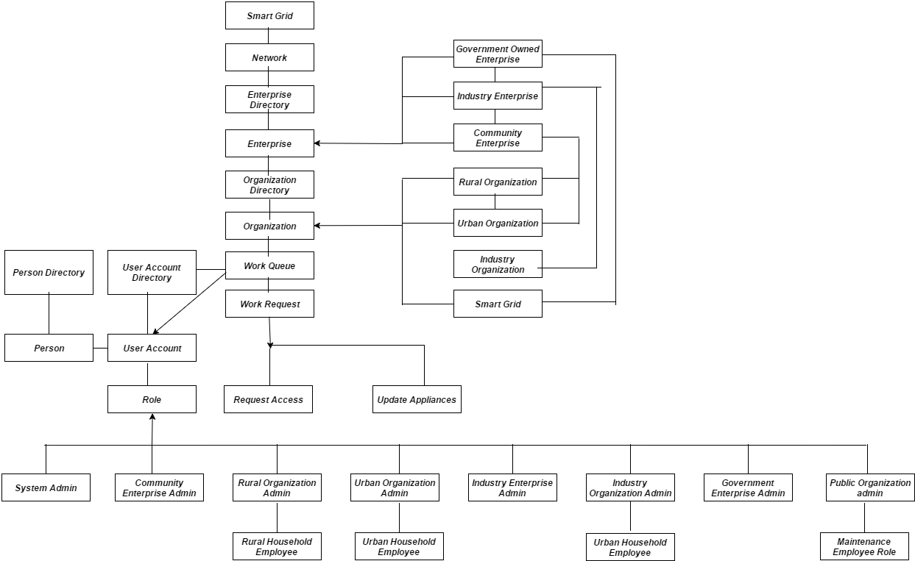
Object Model

Slide 6
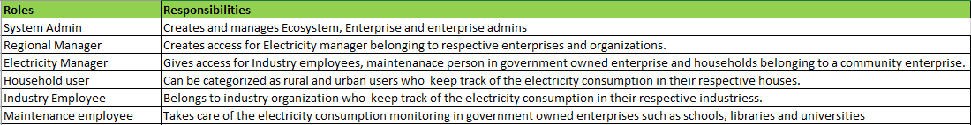
Key Roles

Slide 7
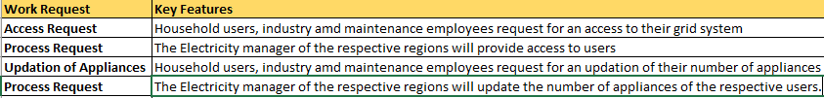
Key Features

Slide 8
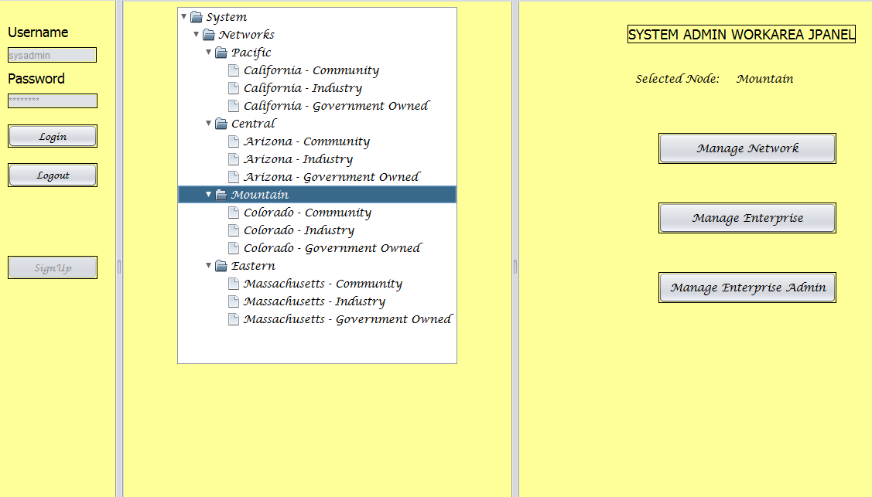
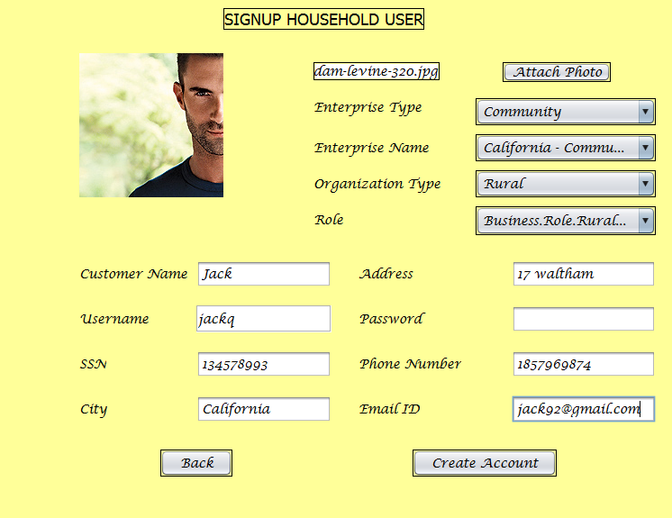
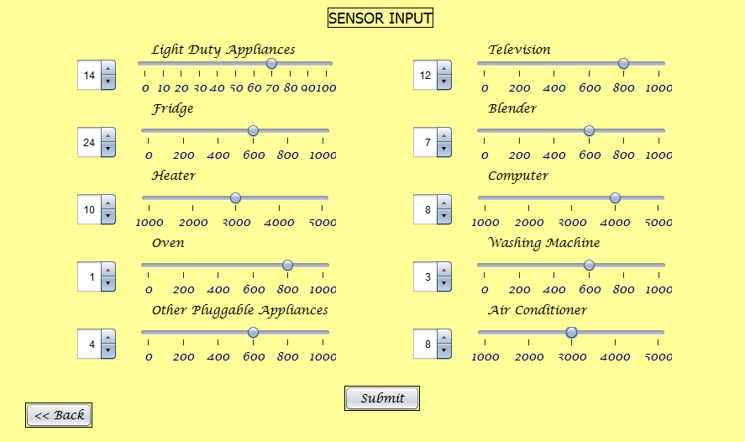
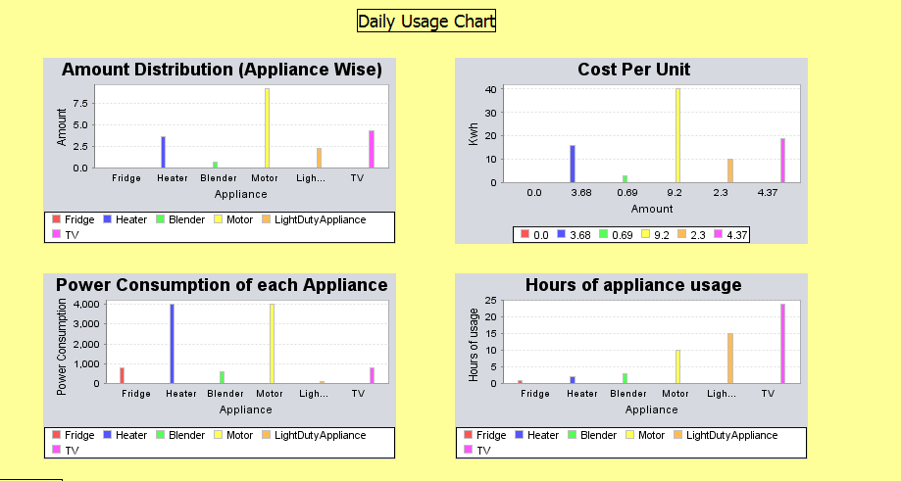
Interface

Slide 9
Future Enhancements
Public places will have digital devices where people will be able to see how much energy is being wasted in the city and which devices are causing maximum electricity consumption in their respective areas.
Making people aware will help them realize the mistake and use electricity with caution.
Monthly bill statements will have information on the wastage of electricity that will be generated for each and every households..

Slide 10
Thank you! ☺

